Slide 1

Sentimental Analysis
Presented By: Husnain Ahmed
Registration #:
B21F0126AI017

Slide 2
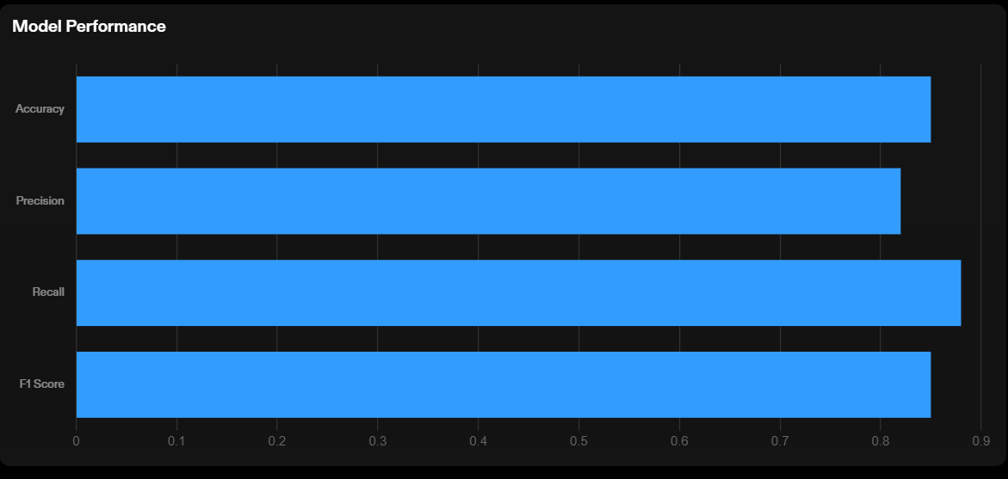
Evaluation of Results

Slide 3
Evaluation of Results
Strengths
The current model accurately predicts sentiment for a majority of the test data.
The model demonstrates a high level of precision and recall.
Limitations
The model struggles with accurately predicting sentiment for certain types of text, such as sarcasm or irony.
The model may produce false positives or false negatives in certain cases.
The model's performance may vary depending on the quality and diversity of the training data.

Slide 4
Improvement Strategy
Feature Engineering
Identify and include additional relevant features in the analysis.
Consider creating new features based on domain knowledge and insights
Model Tuning
Experiment with different algorithms and hyperparameter settings.
Optimize the model's performance by fine-tuning the parameters.
Additional Data Collection
Gather more data to increase the size and diversity of the dataset.
Include data from different sources or time periods to capture a wider range of sentiments.

Slide 5
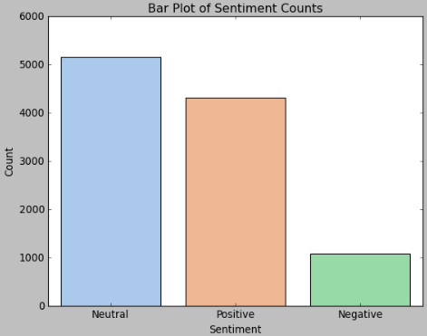
Visualization Support
Key Findings
Majority of sentiments expressed were Neutral, accounting for 50% of the total.
Positive sentiments were observed in 33% of the data, indicating a lack of strong opinions.
Negative sentiments were present in 17% of the data, highlighting areas of concern.

Slide 6
Conclusion
Summary of Findings
The sentimental analysis revealed valuable insights into customer opinions and emotions towards our brand and products.
Overall, the sentiment was mostly Neutral, with customers expressing satisfaction and appreciation for our products/medicine.
However, there were also some negative sentiments expressed, particularly regarding customer service and product pricing.
Recommendations
Based on the findings, I recommend the following strategies:
Improve customer service by addressing concerns and providing timely and helpful assistance.
Review feedback strategy to ensure the safe delivery of the product.
Enhance product quality and features based on customer feedback and preferences.
Closing Statement
In conclusion, the sentimental analysis has provided valuable insights that will guide our decision-making and help us improve our products and services.
By addressing the identified areas of improvement and leveraging the positive sentiments, we are confident in our ability to enhance customer satisfaction and drive business growth.

